Slide 1
104KM Enterprise Information System
Topic: Structured Query Language (SQL)
Learning outcomes for today
What is SQL?
SQL Commands
Examples
Summary

Slide 2
Objectives of SQL
Ideally, a database language should allow a user to:
create the database and relation structures;
perform basic data management tasks, such as the insertion, modification and deletion of data from the relations;
perform both simple and complex queries

Slide 3
What is SQL?
SQL is a special-purpose programming language used for managing data held in a relational database management system (RDBMS).
Overall, SQL includes:
creating tables,
insert data, query, update, delete
data access control

Slide 4
Types of SQL
Microsoft SQL Server using T-SQL
Oracle using PL/SQL (We will be using this one!)
(PL/SQL is a procedural language design to embrace SQL statements within its syntax.)
Microsoft Access version of SQL

Slide 5
Why do we need SQL?
To model the relational database
To manage the data within the database
To query the database

Slide 6
SQL Functions
SQL functions fit into two broad categories:
Data Definition Language (DDL)
SQL includes commands to:
Create database objects such as tables, indexes and views
Define access rights to those database objects
Data Manipulation Language (DML)
Includes commands to insert, update, delete, and retrieve data within database tables.

Slide 7
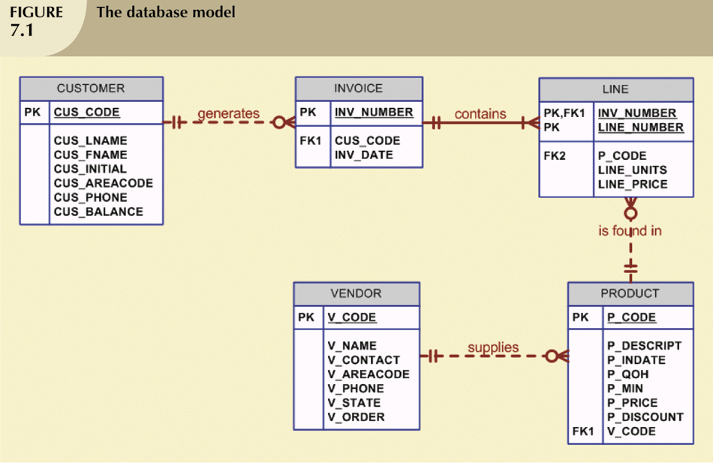
Example - The Database Model

Slide 8
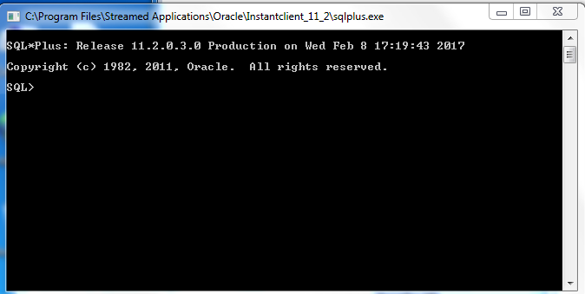
Oracle SQL+
Below is the screenshot of an Oracle SQL+ you will be using in the lab:

Slide 9

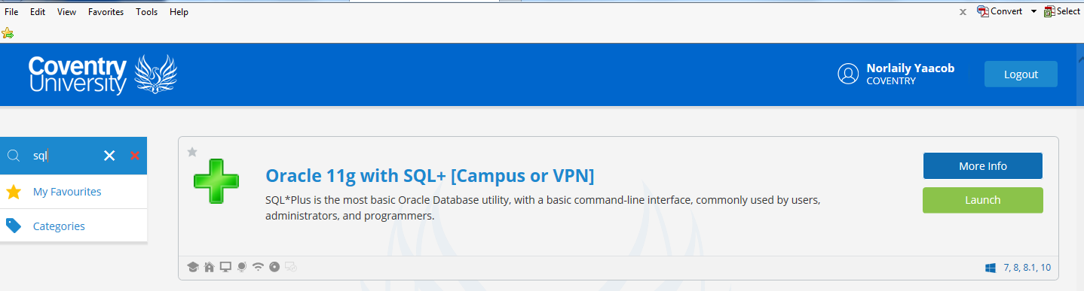
Oracle SQL+ - Where from?
Step 1: Select the myLaunch icon from deskstop.
Step 2: Search for: Oracle SQL+

Slide 10
Oracle SQL+
Step 3: Launch Oracle 11g with SQL+
Step 4: The following screen will appear:
Wait until the SQL prompt
“SQL> “ is displayed, and then typed the following:
connect /@acal
SQL> quit <to exit>

Slide 11
Why Oracle SQL+?
Oracle is used throughout the world.
Command-line.
Next year, you might explore more graphical packages that offer you tool to aid development of SQL statements.
But now, you need to understand how to develop SQL statements and queries.

Slide 12
The Rules
Objects, identifiers, etc. identified by names
Names not case-sensitive
Naming Rules:
must start with a letter
valid A-Z, a-z, 0-9, _ ($,# not encouraged)

Slide 13
Rules
Not case sensitive unless indicated otherwise
Keywords cannot be split across lines
Keywords normally written in uppercase
Clauses are usually placed on separate lines
To improve readability and for ease of editing
In SQL+, each statement is terminated with a “;”

Slide 14
Data Types
String types
CHAR(n) – fixed-length character data, n characters long
Maximum length – 2000bytes
VARCHAR2(n) – variable length character data
Maximum 4000 bytes
LONG – variable-length character data, up to 4GB.
Max 1 per table
DATE - 2-digit number for Day, 3 letters for month,
2 – digit number for the year
e.g. 7th January 2014 stored as 07-jan-14

Slide 15
More Data Types
Numeric types
NUMBER(L,R) – general purpose numeric data type
L – max number of significant decimal digits or the
precision
R – number of digits from the decimal point to the
least significant digit or the scale
NUMBER(5,2) – max value 999.99
NUMBER(5) – max value 99999
INTEGER – signed integer

Slide 16
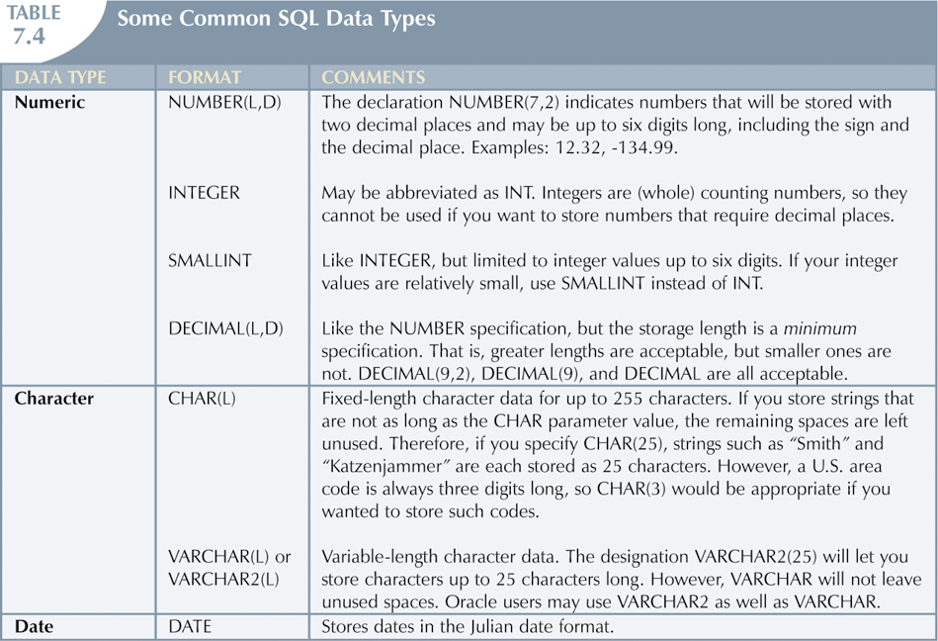
Common SQL Data Types

Slide 17
Data Manipulation Commands
Concerned with the structure of the database. It defines
the structure of database and controlling access to data.
Example - Command statements:
CREATE
DROP
ALTER
COMMIT

Slide 18
TABLES
CREATE TABLE statement can be used to create a table.
Tables contain columns and constraints, rules to which data must conform.
Specify:
name of the table
names of column/attributes
data type of each column/attribute
size of each column/attribute

Slide 19
CREATE the table
CREATE TABLE Mytable
(id NUMBER(2),
name VARCHAR2(9));

Slide 20
SQL Constraints
The aim is to prevent invalid data in Databases. Commonly used constraints available in SQL are:
NOT NULL Constraints: column must contain a value
PRIMARY KEY Constraints: Uniquely identified each rows/records in a database table
FOREIGN KEY: Uniquely identified a rows/records in another database table

Slide 21
Key in a table
A key in a table is a field or group of fields that creates identity, makes relationship with another table and/or make a table more efficient.

Slide 22
Primary Key & Foreign
A Primary key is a key that uniquely identifies a row in each table. It is normally denoted with its first two letters, namely, PK.
A Foreign key is a key borrowed from another related table (that’s why its foreign) in order to make the relationship between two tables. It is normally denoted with its first two letters, namely, FK.

Slide 23
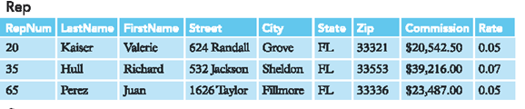
Example – Primary Key
Repnum uniquely identifies the Rep table
and is the primary key of this table.

Slide 24
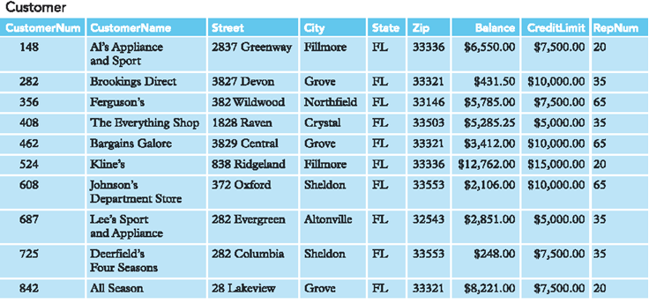
Example - Primary Key
Customernum uniquely identifies the Customer table
and is the primary key of this table.

Slide 25
Example – Foreign Key
Repnum is a Foreign key borrowed from Rep table

Slide 26
Example
CREATE TABLE employees(
emp_id NUMBER(5) PRIMARY KEY,
emp_name VARCHAR2(15) NOT NULL,
dept_id NUMBER(4));

Slide 27
What about the Foreign Key?
CREATE TABLE employees(
emp_id NUMBER(5) PRIMARY KEY,
emp_name VARCHAR2(15) NOT NULL,
dept_id NUMBER(4),
CONSTRAINT emp_dept_fk
REFERENCES departments(dept_id));
OR
ALTER TABLE EMPLOYEES
ADD CONSTRAINT DEPT_ID_FK FOREIGN KEY(DEPT_ID)
REFERENCES DEPARTMENTS(DEPT_ID);

Slide 28
Altering a table
For changing the structure of a table:
Adding a new column
Modifying the definition of an existing column
Deleting a column
Defining a default value for a new column
Example:
ALTER TABLE employees
ADD address VARCHAR2(30);

Slide 29
Delete a Column
The rules:
May of may not contain data
Table must have at least one column remaining
Primary key referenced by another column cannot
be deleted without the cascade option
Example:
ALTER TABLE cust_table
DROP cust_age;

Slide 30
Inserting the Data
Created the table? Yes, now insert the data.
Example:
INSERT INTO employees values (12345,’John Jack’,5678);

Slide 31
COMMIT
A COMMIT statement ends a transaction successfully.
Make changes to a database permanent.
Use a COMMIT statement to save your work.
Example:
COMMIT;

Slide 32
Drop a table
Drop Table:
Removes table from the database
Example:
DROP TABLE tablename;

Slide 33
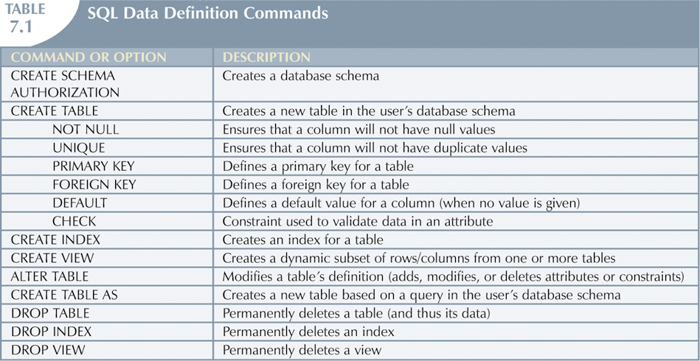
Summary - SQL Data Definition Commands

Slide 34
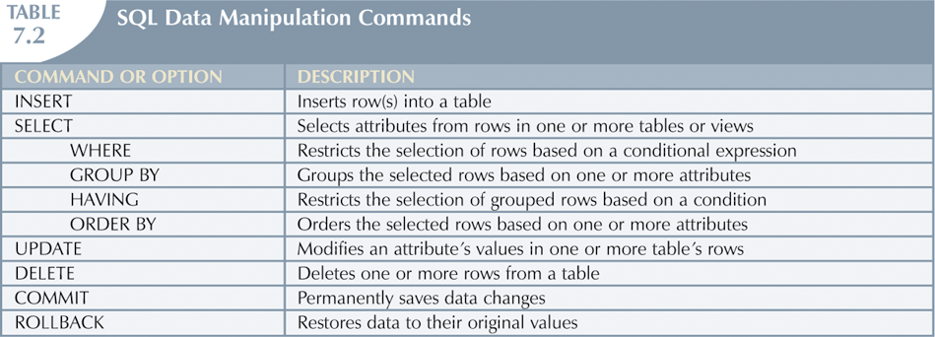
Summary - SQL Data Manipulation Commands

Slide 35
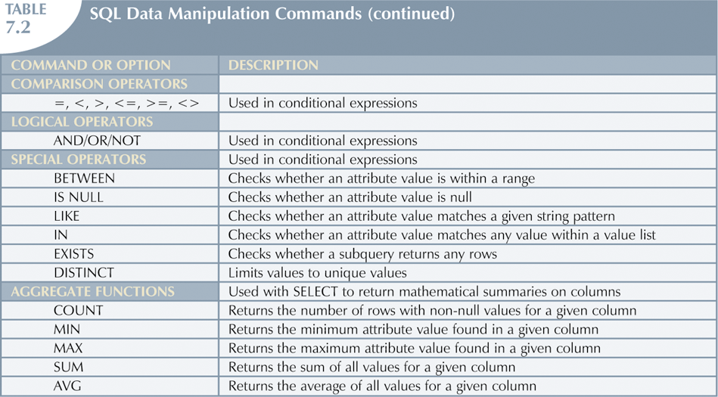
Summary - SQL Data Manipulation Commands

Slide 36
More info here!!
1. W3Schools.com
http://www.w3schools.com/sql/
2. http://www.tutorialspoint.com/sql

